Slide 1
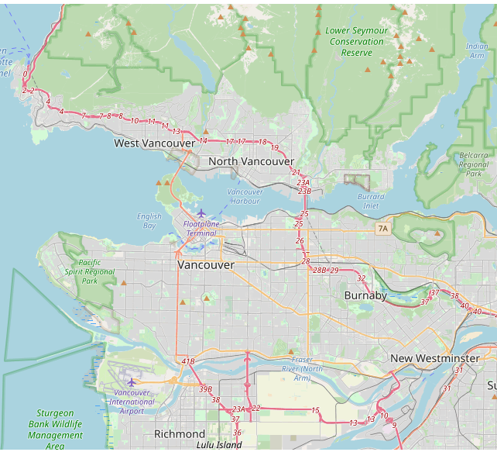
Restaurants in Vancouver
?
?
Where are they located?

Slide 2
The Goal
To acquire new listings
Why Restaurants?
Because they are a vibrant sector

Slide 3
Which Restaurants?
Full service
Including
Pizza, Burger, Fried Chicken and Diners

Slide 4
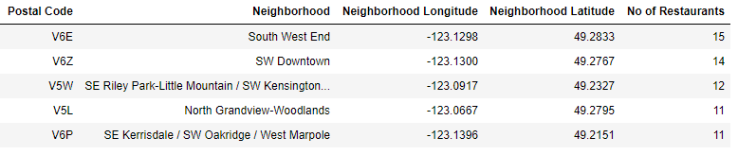
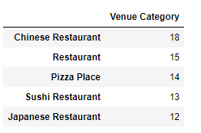
Top 5: Neighborhoods and Type

Slide 5
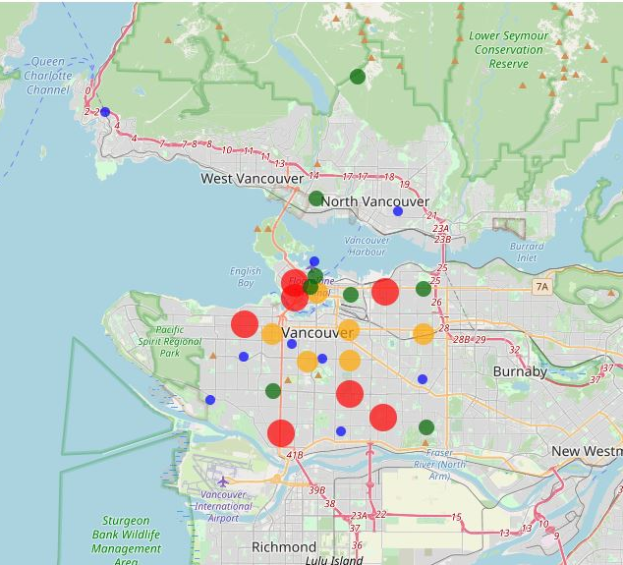
Restaurant concentration
Larger circle denotes Higher number of Restaurants

Slide 6
Conclusion
Most promising area: Harbor
Also promising: South
Don’t go North of Harbor

Slide 7

Entire data set and clickable map
Click HERE

Slide 8

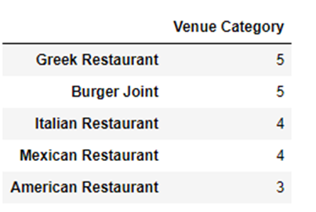
Fun Fact
More Greek Restaurants than Italian!
This Photo by Unknown Author is licensed under CC BY-SA

Slide 9
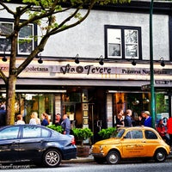
Good Luck!
Get More Listings!

